Slide 1


Slide 2
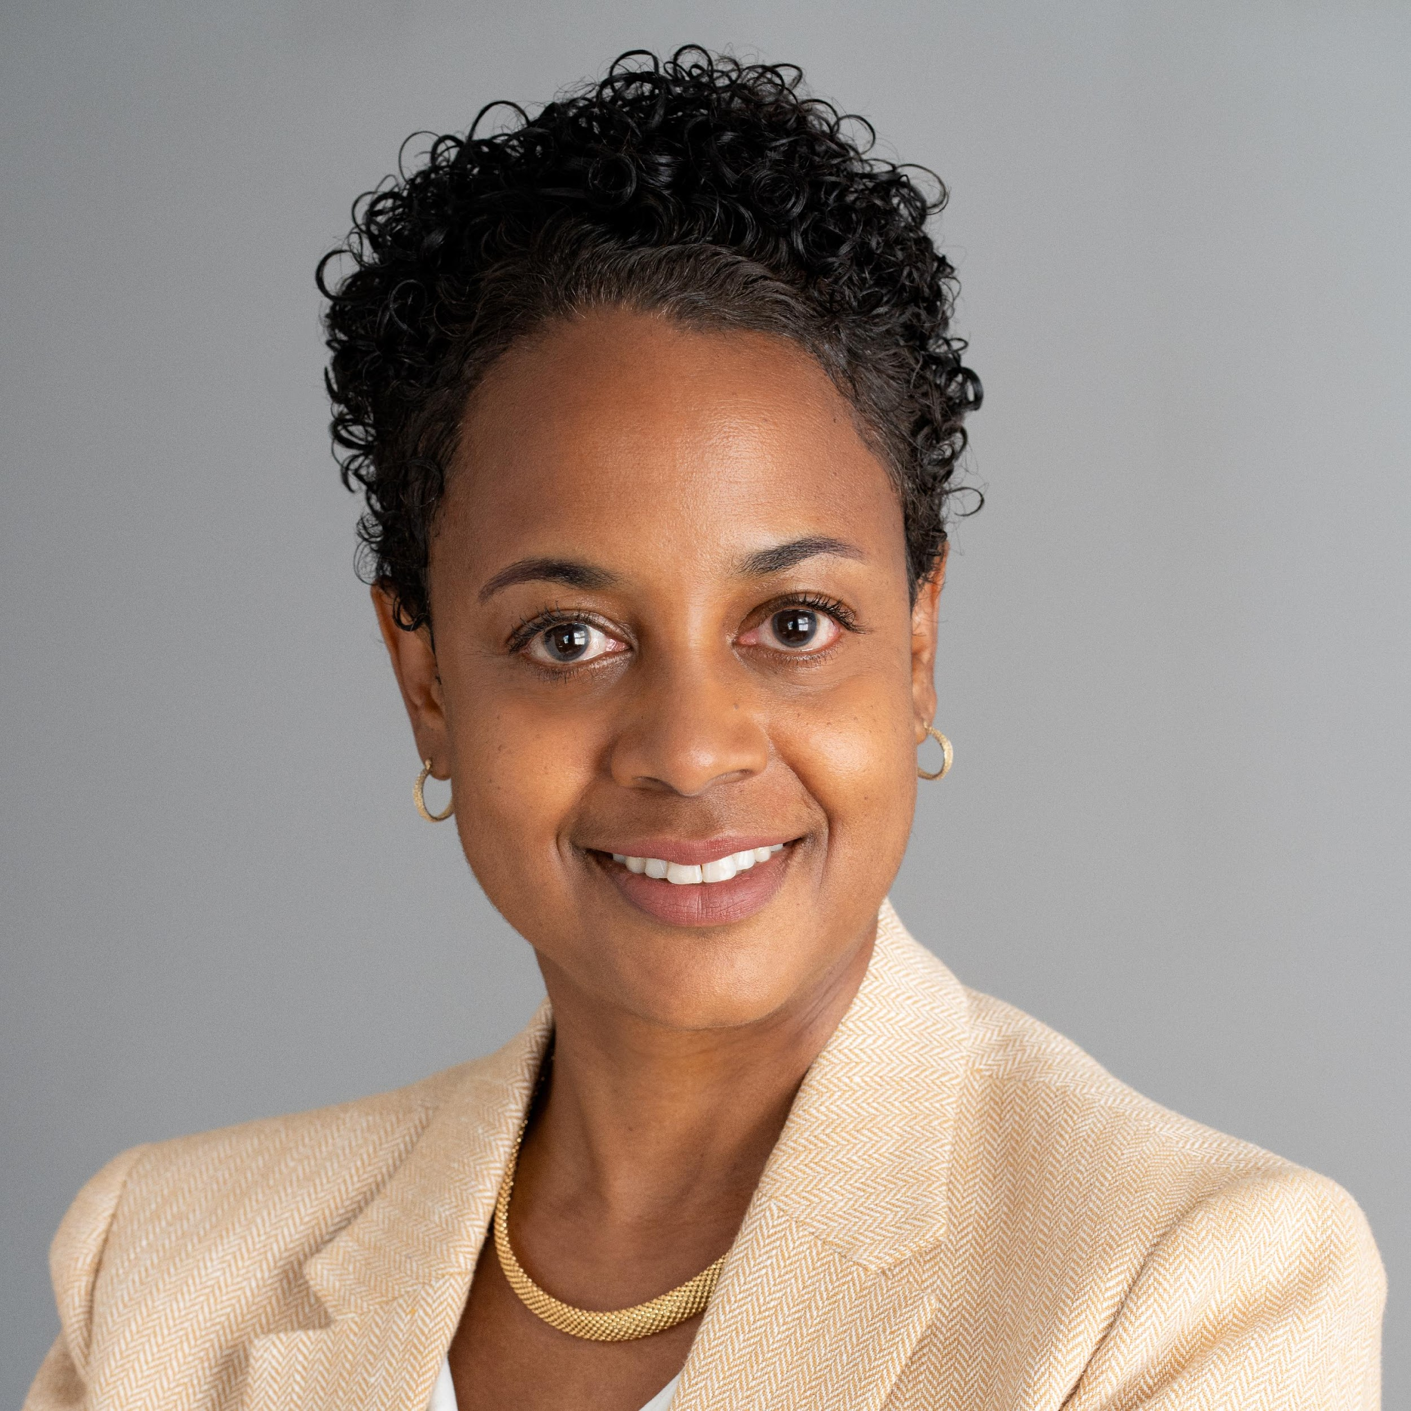
Sandra Hill-Glover VP of Learning & Innovation
Center for Nonprofit
Management (CNM)

Slide 3
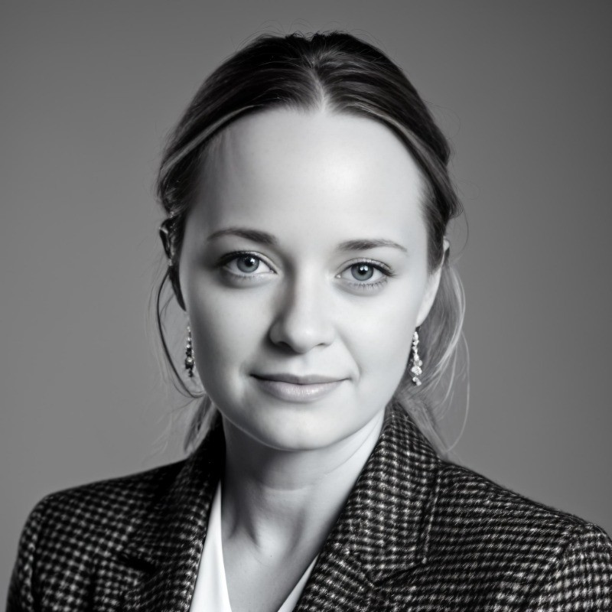
Tirzah Van Damme Global AI Strategy Lead for UN & IGOs
Microsoft

Slide 4

Notes:
https://www.youtube.com/watch?v=nqlYgj17wL4

Slide 5
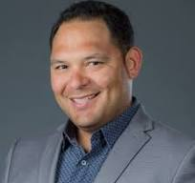
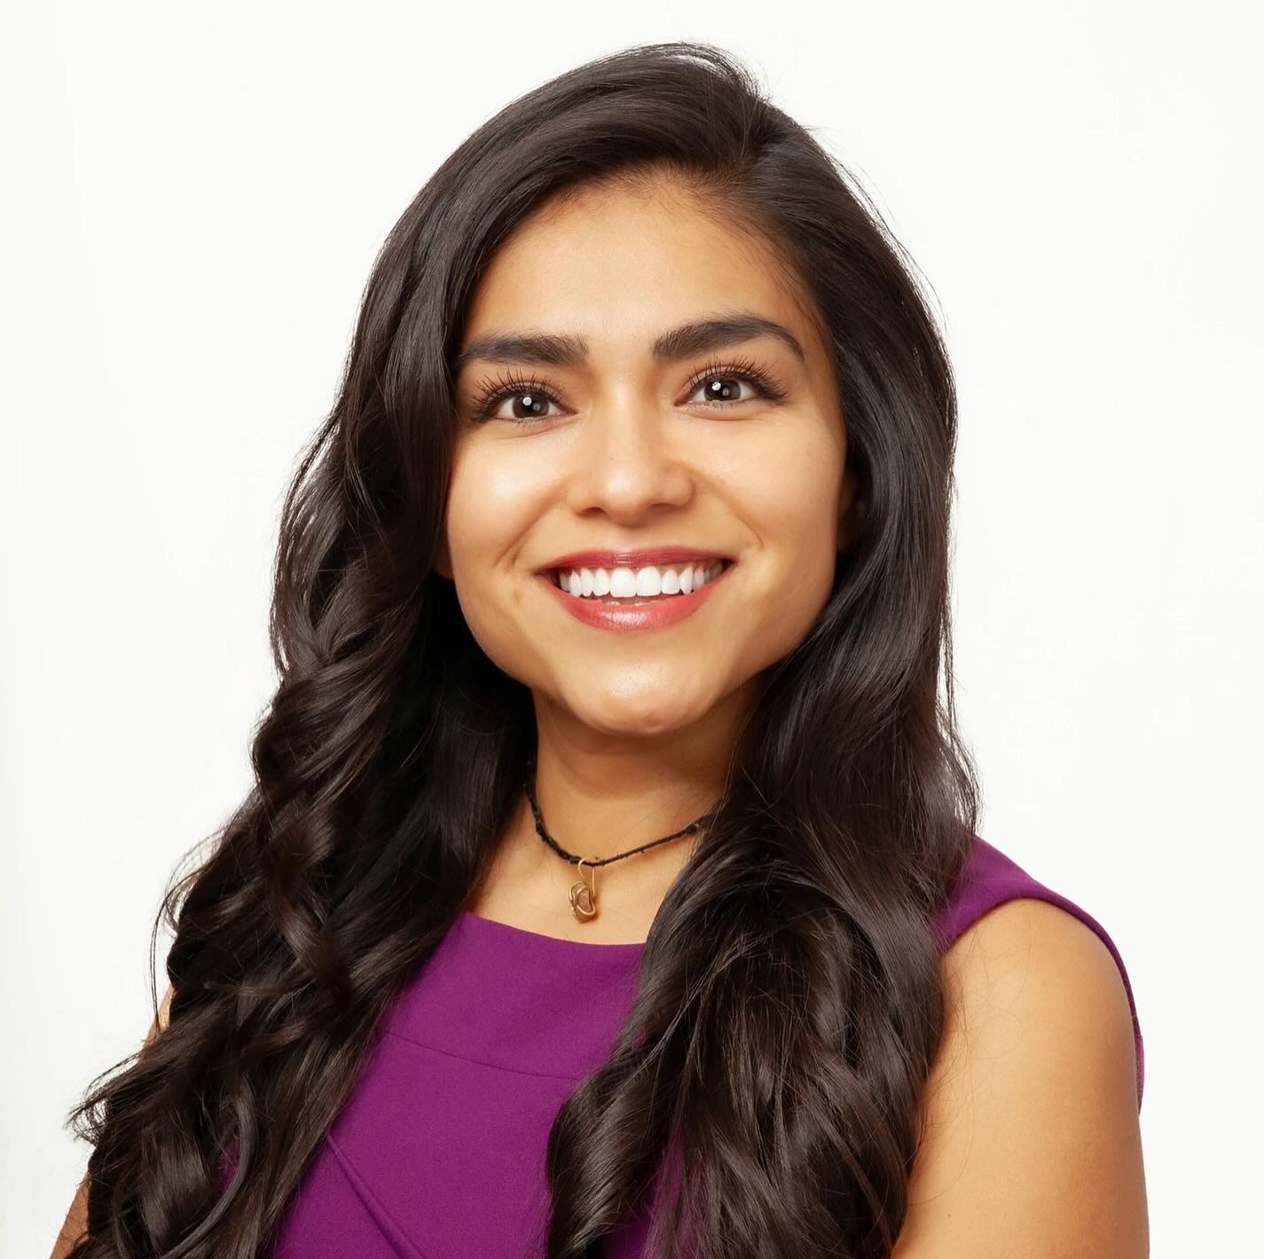
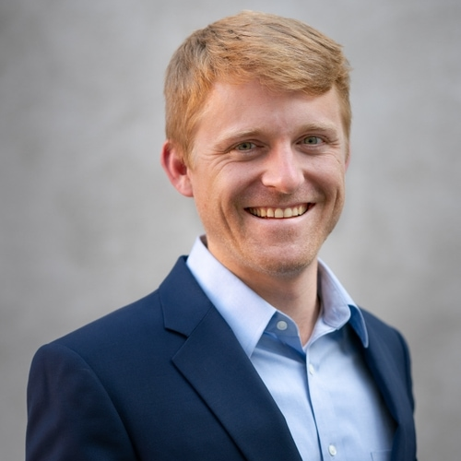
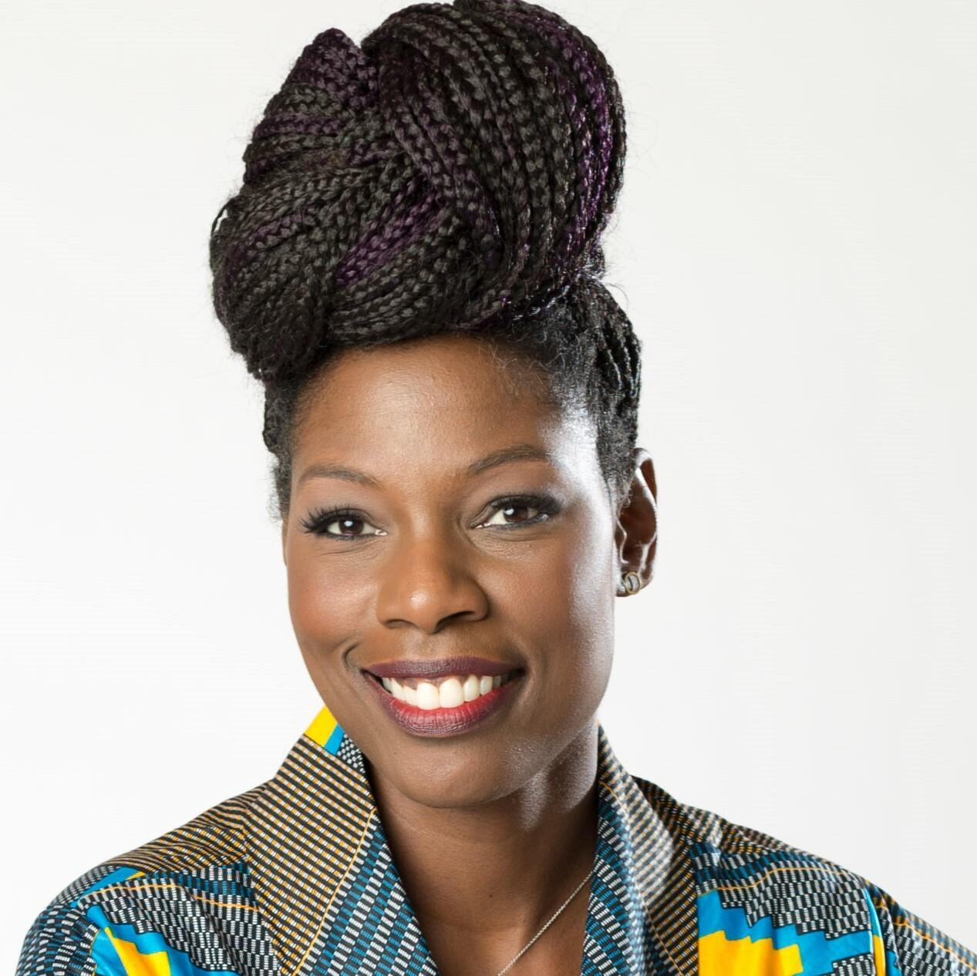
Jen Garcia Employ California
Nonprofit Organizations’ AI Success Stories
Todd Terrazas AI LA
Erika Smith Microsoft
Efrain Escobedo Center for Nonprofit Management
Moderator
Panelist
Panelist
Panelist

Slide 6


Slide 7
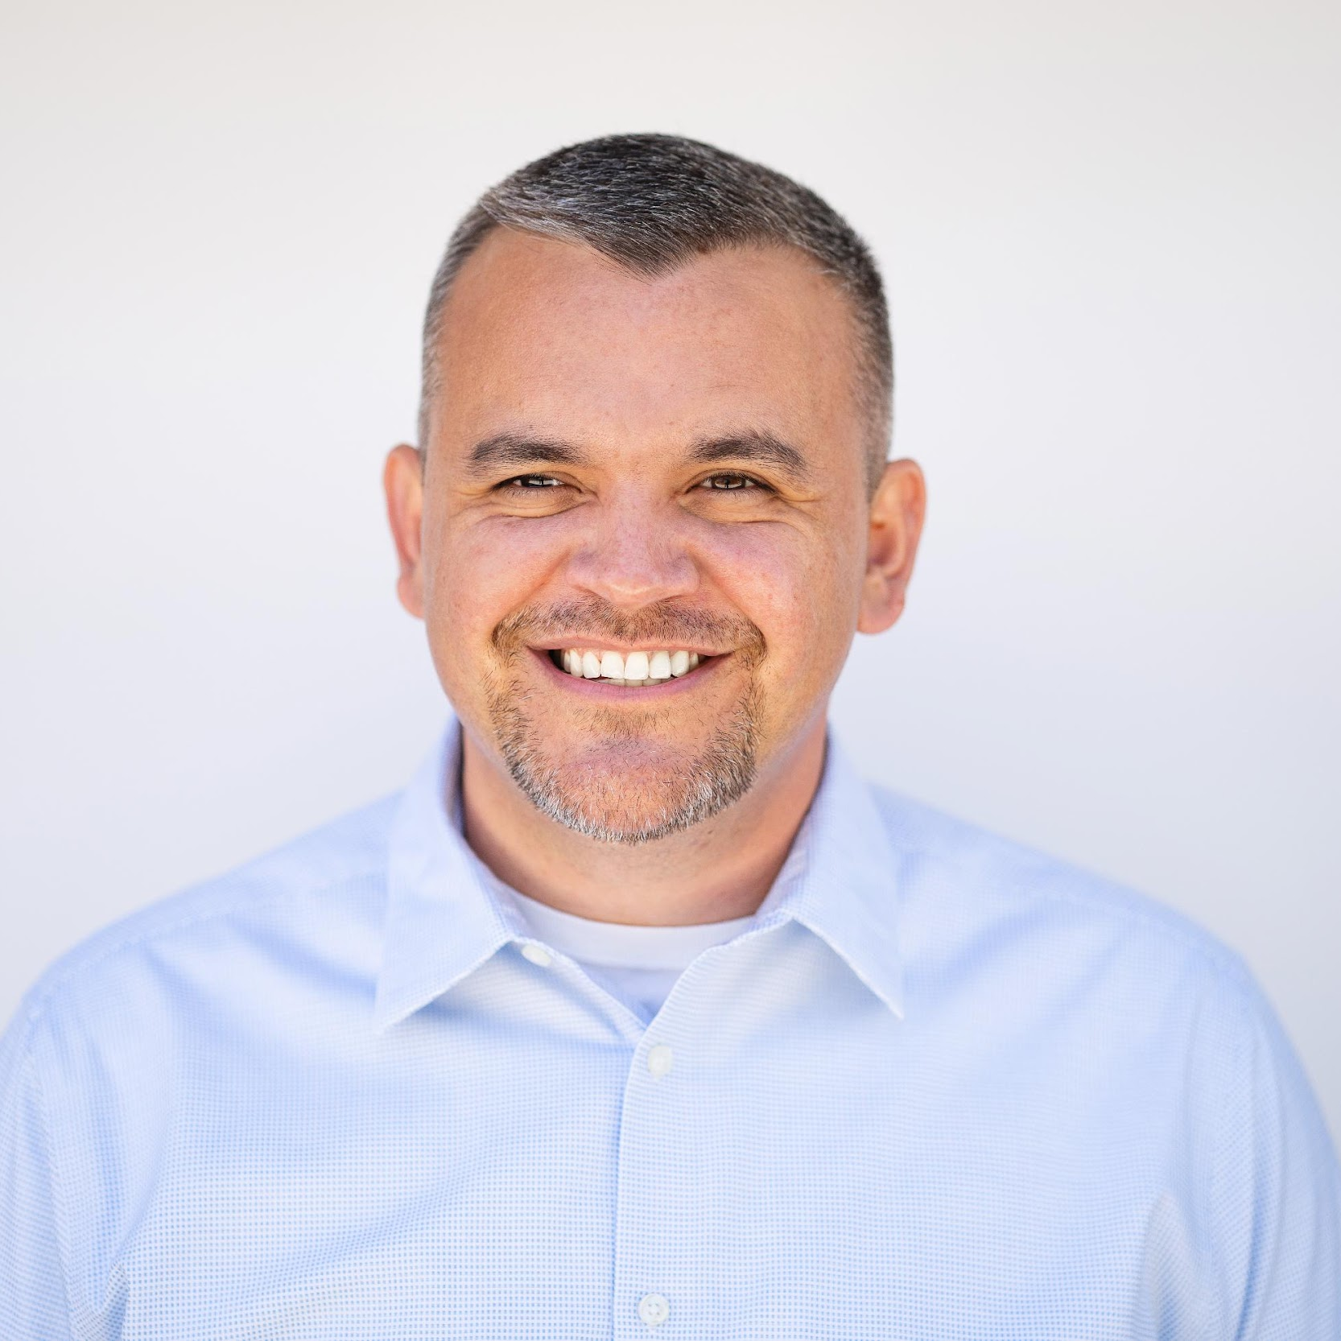
Joey Zumaya Head of Nonprofit Enterprise Sales & Strategy
LinkedIn

Slide 8
Sandra Hill-Glover VP of Learning & Innovation
Center for Nonprofit
Management (CNM)

Slide 9

FINAL REFLECTIONS

Slide 10
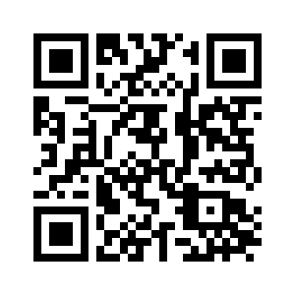

CONFERENCE EVALUATION

